Slide 1

ESKİŞEHİR TECHNICAL UNIVERSITY
Engineering Faculty
Plant Expert - Plant Disease Detecting System
Esin MEŞELİ
Maabb ZAKOUR
Department: Computer Engineering
Instructor: Dr.Burcu YILMAZEL

Slide 2


Plant Expert
Plant Disease Detection System

Slide 3

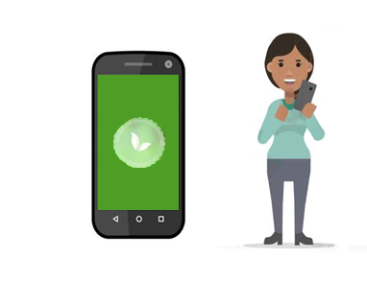
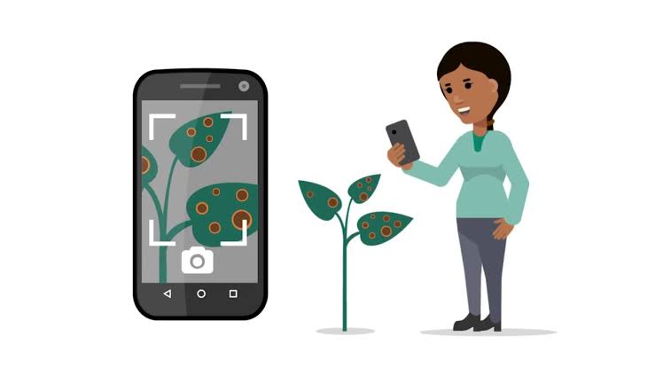
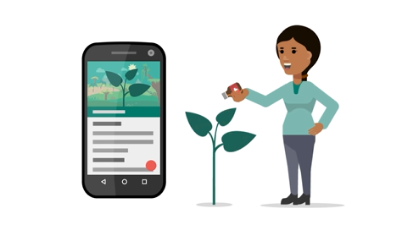
What is Plant Expert?
Plant Expert is a user-friendly mobile application which is easy to use.
It finds the disease in the plant by analyzing the photo of the user's plant.
After detecting the disease, it provides the necessary treatment information to the user.

Slide 4
What Is Our Difference ?
Available applications:
Xarvio: It aims to simplify farmer’s work by developing solutions for crop optimization of agriculture.
PictureThis: It is able to identify the plant species through photography, thus creating a community for plant lovers.
We want people to move away from the stress of daily work and city life and spend time with the soil and discharge. Therefore our application will be stress-relief app with its content being simple and enjoyable.
The other difference is our application is a domestic product as well as being able to work more quickly and consistently in the process of identification and elimination of the disease.
Also we want to help both the farmers which grown their plants in the village and citizens who grow it in their balconies. Therefore application doesn’t have as much complex interface or content as other applications, it can appeal to all kind of users, so that users can easily use it.

Slide 5













Meet Our Team
Esin Meşeli
Software Engineer
Maabb Zakkour
Software Engineer
Image Processing
Data Analysis
Machine Learning Algorithms
Image Processing
Mobile Programming

Slide 6
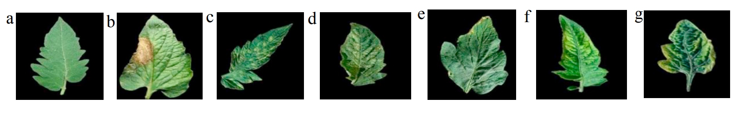
What Did We Do?
Agriculture affects not only the sector but also the whole country directly because of the basic products it produces. Especially it’s in a very important position as it provides the continuation of generations. Since agricultural production depends on natural conditions, risk and uncertainty are high. For this reason, our project is to increase the practices supporting agriculture and encouraging it.
As a start we found the appropriate dataset for the project that we searched the observable and detectable diseases of plant tomato leaves before.
a) Healthy
b) Late Blight
c) Leaf Mold
d) Two-spotted
spider mine attack
e) Target spot
f) Tomato mosaic virüs Disease
g) Tomato yellow
curl virus disease

Slide 7
What Did We Do?
After the basic stages of the project divided into time intervals, system analysis and design was done. Then we divided the programming stage into 3 parts:
Image Processing.
Learning Algorithms.
Mobile Programming.
Proposed methodology for Image Processing:
Image Acquisition
Image Pre-processing
Image Segmentation
Features Extraction in Image

Slide 8
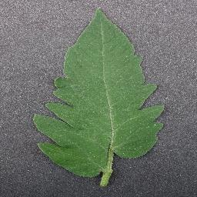
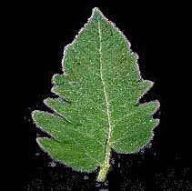
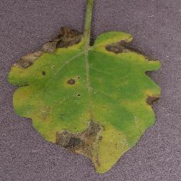
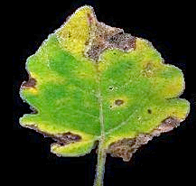
What Did We Do?
The images in the dataset to be processed were edited with image processing algorithms before they were given to the model training. These adjustments consisted of a number of operations such as:
Background removal.
Synchronization of image size.
Making colors and details clearer.
Healty Leaf Image
Diseased Leaf Image
New images after image processing were put into the model for data training.

Slide 9
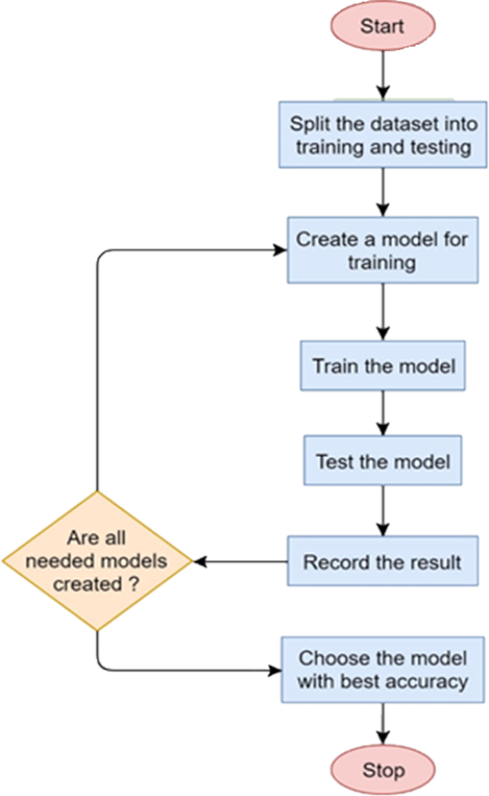




What Did We Do?
We used algorithms including artificial neural networks to create the most consistent model. The training of the model consists of the steps in the figure.
Machine learning and image processing sections will be written on Python in platforms like Pycharm and Spyder using libraries such as Tensorflow and Scikit. We tried to create the most consistent and high success model.
No
Yes

Slide 10
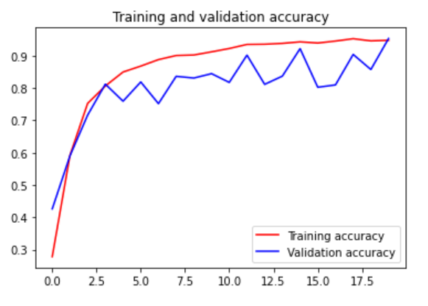
What Did We Do?
We found the latest results as below:
Training Accurancy → 0,96
Test Accurancy → 0,82

Slide 11
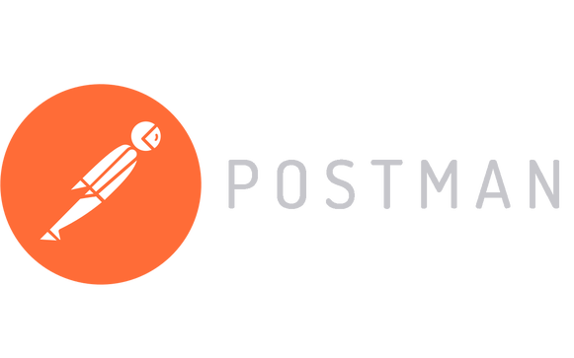
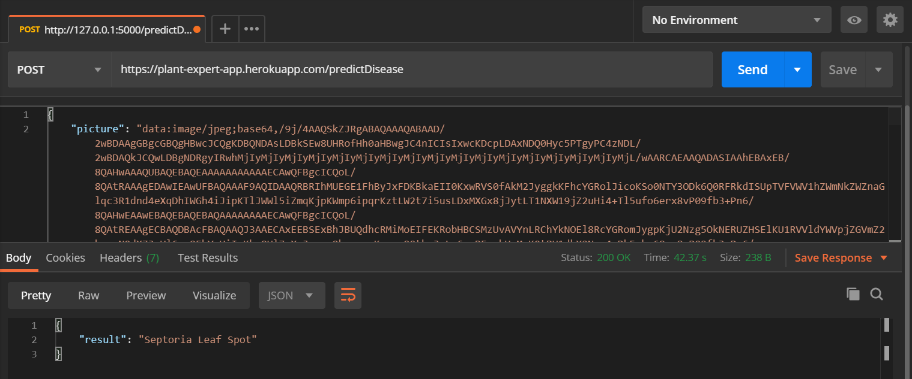
What Did We Do?

Slide 12
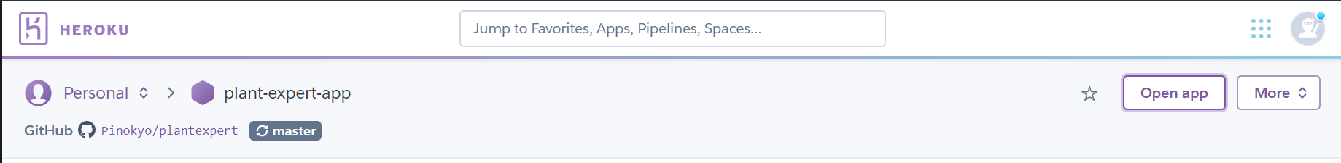
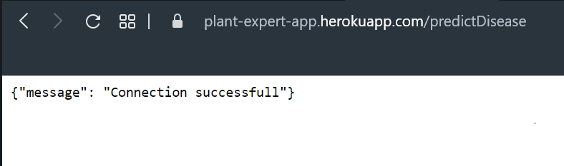


After successfully completing the API part, the mobile programming section was started. The programming language of the mobile application was selected as C# and written on Visual Studio. We are also using Xamarin.

Slide 13
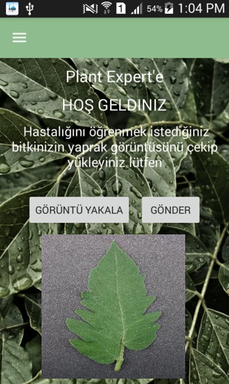
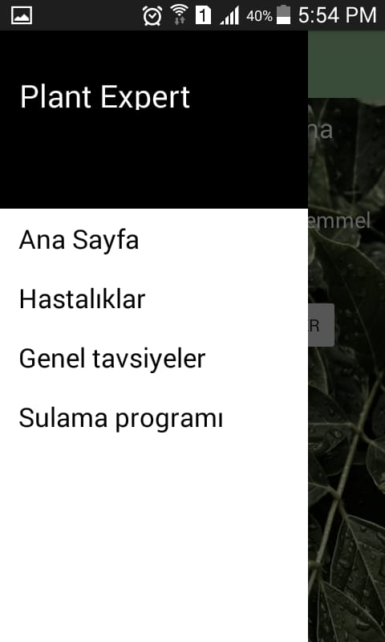


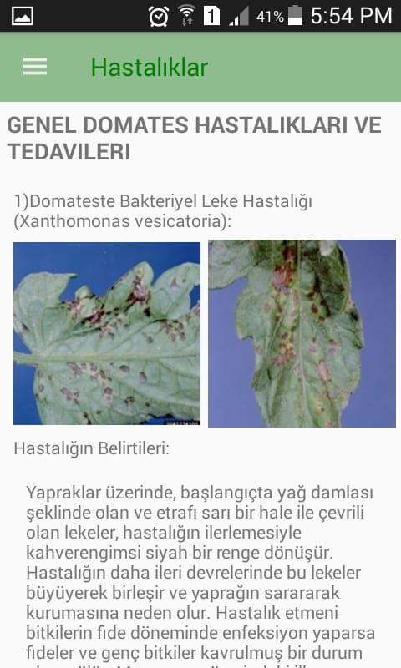
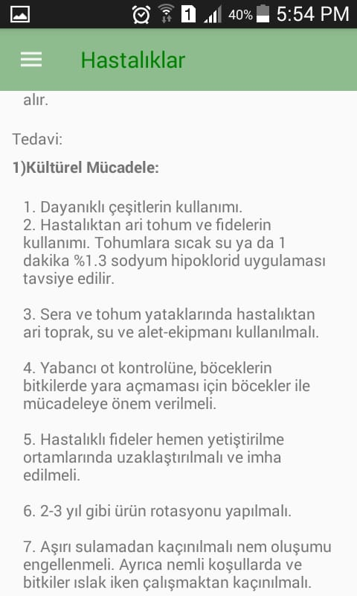
The Application Includes:
It includes main page section which the user can take the results after taking the leaf image and uploading it to the system. After that user can read the necessary treatment information.
Also there is a “Hastalıklar“ section where the user can learn (independently from taking and uploading the photo) the diseases of the plant, how these diseases can occur and appropriate treatment.
In the following process, some features such as irrigation schedule, spraying reminders, weather and wind notification are considered to be added to the application.

Slide 14
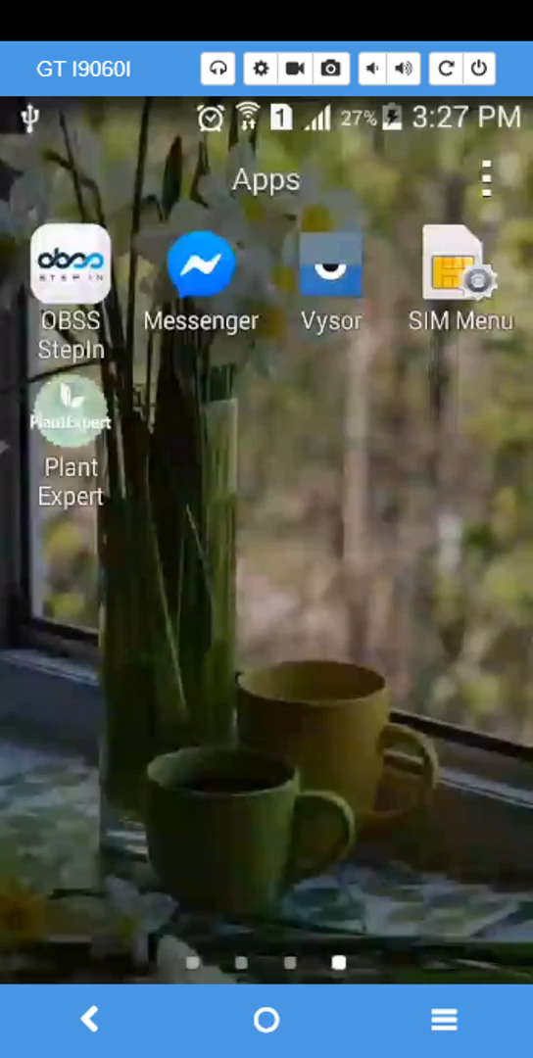
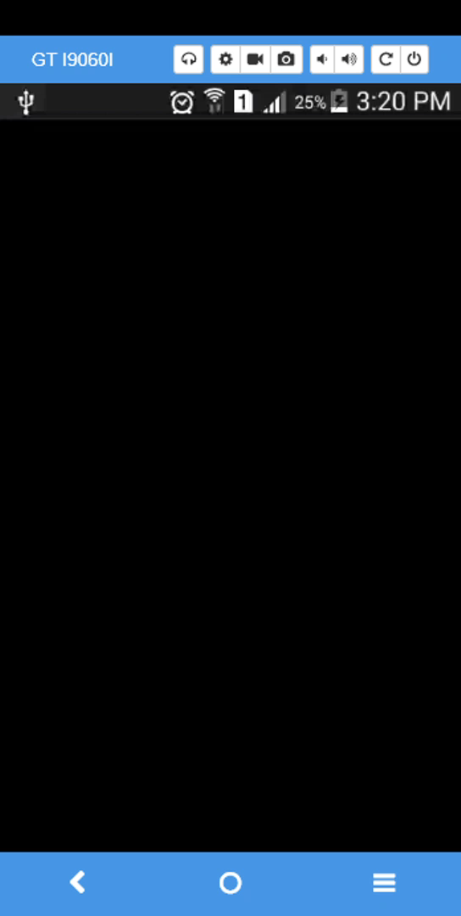
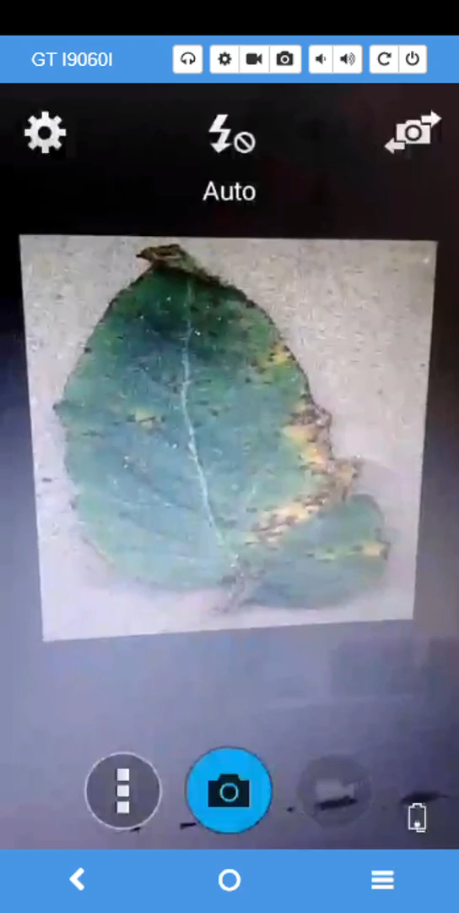

Slide 15


This project is
supported
by TUBİTAK
Thanks for listening
Plant Expert
" Chop your own wood and it will warm you twice "
- Henry Ford
Esin MEŞELİ
esinbm@eskisehir.edu.tr
0531 836 44 96
Maabb ZAKOUR
maabbzakour@eskisehir.edu.tr
0536 698 27 46

